Slide 1

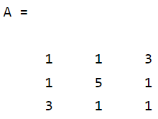
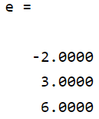
Eigen values and Eigen vectors continued...
Find the eigenvalues and the corresponding eigenvectors of the matrix A= [1,1,3;1,5,1;3,1,1].
>> A=[1,1,3;1,5,1;3,1,1]
>> e=eig(A)

Slide 2

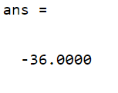

Eigen values and Eigen vectors continued...
>> det(A)
>> prod(eig(A))
Therefore, det(A)=prod(eig(A))
>> sum(eig(A))

Slide 3
Eigen values and Eigen vectors continued...
>> trace(A)
Therefore, sum(eig(A))=trace(A)

Slide 4
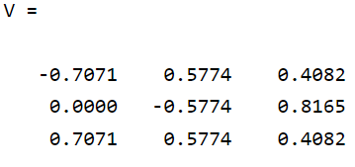
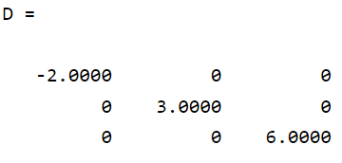
Eigen values and Eigen vectors continued...
Finding Eigenvectors of the matrix A:
>> [V,D]=eig(A)

Slide 5
Eigen values and Eigen vectors continued...
Problems:
Find the Eigenvalue and the corresponding Eigenvectors of
A=[1,-1,1;1,0,0;-1,1,-1].
Find the Eigenvalue and the corresponding Eigenvectors of
A=[1,3,1;4,1,3;2,1,3]
Find the Eigenvalue and the corresponding Eigenvectors of
A=[2,3,4;5,3,2;1,2,2]
.

